Slide 1
Onwards and Upwards
Mark Behrens

Slide 2
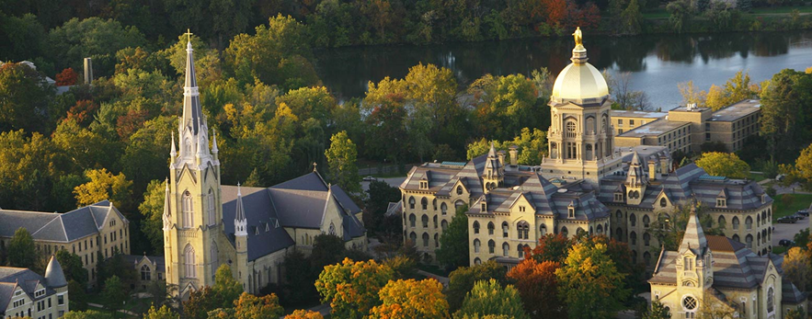

Shameless
Plug:
ND undergrad Geom/Top workshop
Annual, starting summer 2017
First part “basic notions in geometey/topology”
Second part “undergrad research conference”
ND graduate Ph.D. program
6 geometry faculty
6 topology faculty
10 grad students in topology
Several topology/geometry seminars
RTG grant in geometry and topology

Slide 3
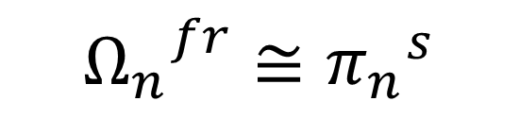
Pontryagin-Thom Construction
$${Ω_{n}}_{ }^{fr}≅{π_{n}^{ }}^{s}$$

Slide 4
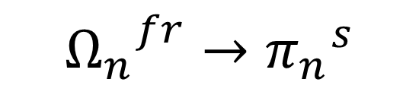
Pontryagin-Thom Construction
$${Ω_{n}}_{ }^{fr}→{π_{n}^{ }}^{s}$$

Slide 5
Pontryagin-Thom Construction
$${Ω_{n}}_{ }^{fr}→{π_{n}^{ }}^{s}$$

Slide 6
Pontryagin-Thom Construction
$${Ω_{n}}_{ }^{fr}→{π_{n}^{ }}^{s}$$

Slide 7
Homotopy groups of spheres in low dimensions

Slide 8
π_{<k}(S^{k})
π_{k}(S^{k})
π_{>k}(S^{k})
Notes:
Pi_n S^n

Slide 9
Infinite subgroups completely understood
Notes:
Hopf invariant
Hopf invariant one maps
Adams ‘60

Slide 10
Values stabilize along diagonals:
π_{n+k}(S^{k}) = π_{n+k+1}(S^{k+1}) for k >> 0

Slide 11
Stable homotopy groups:
π_{n}^{s} := lim π_{n+k}(S^{k}) k→∞
Primary decomposition:
π_{n}^{s} = (π_{n}^{s})_{(p)} e.g.: π₃^{s} = Z₂₄ = z₈ + Z₃
p prime

Slide 12
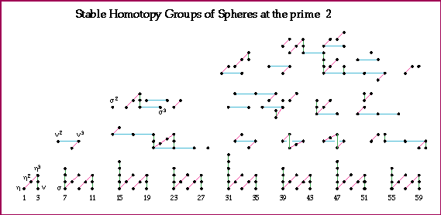
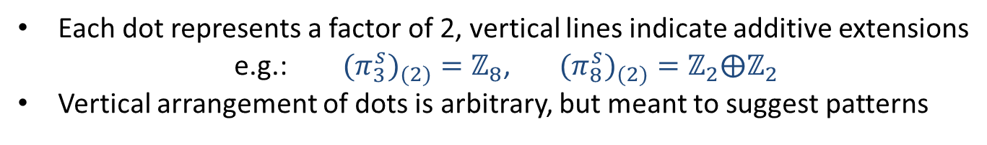
Computation: Mahowald-Tangora-Kochman
Picture: A. Hatcher
Each dot represents a factor of 2, vertical lines indicate additive extensions
e.g.: ${{(π}_{3}^{s})}_{(2)}=ℤ_{8}$, ${{(π}_{8}^{s})}_{(2)}=ℤ_{2}⨁ℤ_{2}$
Vertical arrangement of dots is arbitrary, but meant to suggest patterns

Slide 13

J-homomorphism
$$J:π_{n}SO→π_{n}^{s}≅Ω_{n}^{fr}$$
$$(ℤ/{2,}ℤ/2, 0, ℤ, 0, 0, 0, ℤ,ℤ/2,ℤ/2, 0, ℤ, 0, 0, 0, ℤ,ℤ/2,ℤ/2, 0, ℤ…)$$
0 1 2 3 4 5 6 7 8 9 10 11 12 13 14 15 16 17 18 19

Slide 14
Each dot represents a factor of 2, vertical lines indicate additive extensions
e.g.: ${{(π}_{3}^{s})}_{(2)}=ℤ_{8}$, ${{(π}_{8}^{s})}_{(2)}=ℤ_{2}⨁ℤ_{2}$
Vertical arrangement of dots is arbitrary, but meant to suggest patterns
Notes:
J homo
Adams ‘66

Slide 15
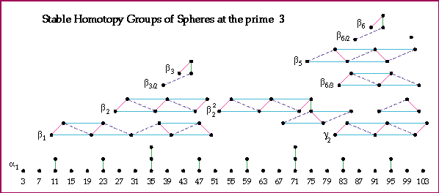
Computation: Nakamura -Tangora
Picture: A. Hatcher

Slide 16
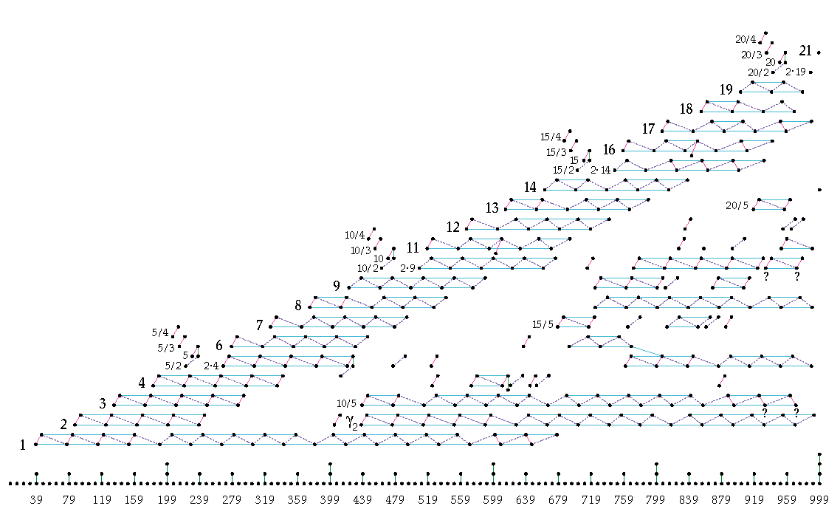
(π_{n}^{s})₍₅₎
Computation: D. Ravenel
Picture: A. Hatcher
n
Notes:
EHP

Slide 17
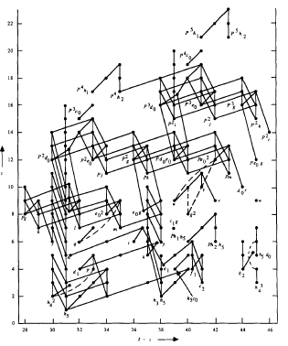
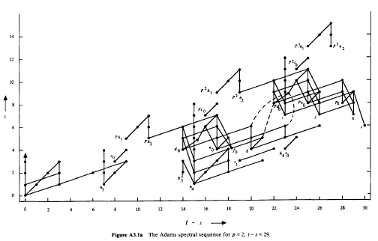

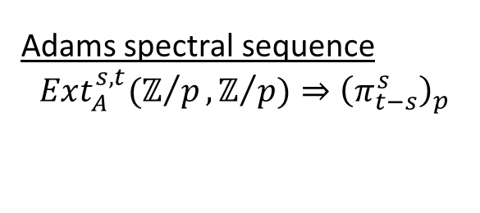
Adams spectral sequence
$$Ext_{A}^{s,t}(ℤ/p,ℤ/{p)⇒{\left(π_{t−s}^{s}\right)}_{p}}$$
$$π_{t−s}^{s}$$

Slide 18
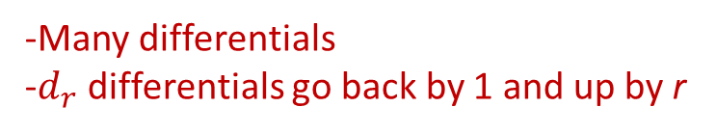
Adams spectral sequence
$$Ext_{A}^{s,t}(ℤ/p,ℤ/{p)⇒{\left(π_{t−s}^{s}\right)}_{p}}$$
$$π_{t−s}^{s}$$
-Many differentials
-$d_{r}$ differentials go back by 1 and up by r

Slide 19

Adams spectral sequence
$$Ext_{A}^{s,t}(ℤ/p,ℤ/{p)⇒{\left(π_{t−s}^{s}\right)}_{p}}$$
$$π_{t−s}^{s}$$
-Many differentials
-$d_{r}$ differentials go back by 1 and up by r
Notes:
HI(x) = 1 ⬄ x detected by h_i
D2(h_i)

Slide 20
Adams spectral sequence
$$Ext_{A}^{s,t}(ℤ/p,ℤ/{p)⇒{\left(π_{t−s}^{s}\right)}_{p}}$$
$$π_{t−s}^{s}$$

Slide 21
Adams spectral sequence
$$Ext_{A}^{s,t}(ℤ/p,ℤ/{p)⇒{\left(π_{t−s}^{s}\right)}_{p}}$$
$$π_{t−s}^{s}$$
Notes:
Kervaire Invariant
Browder ‘69
Barratt-Jones-Mahowald ’85
HHR ’09
Q: h_6^2 PC?
Q: d_r(h_i^2)?

Slide 22

$$Θ_{n}^{bp}$$
Trivial for n even
Cyclic for n odd
  Generated by boundary of an explicit parallelizable manifold given by plumbing construction

Slide 23
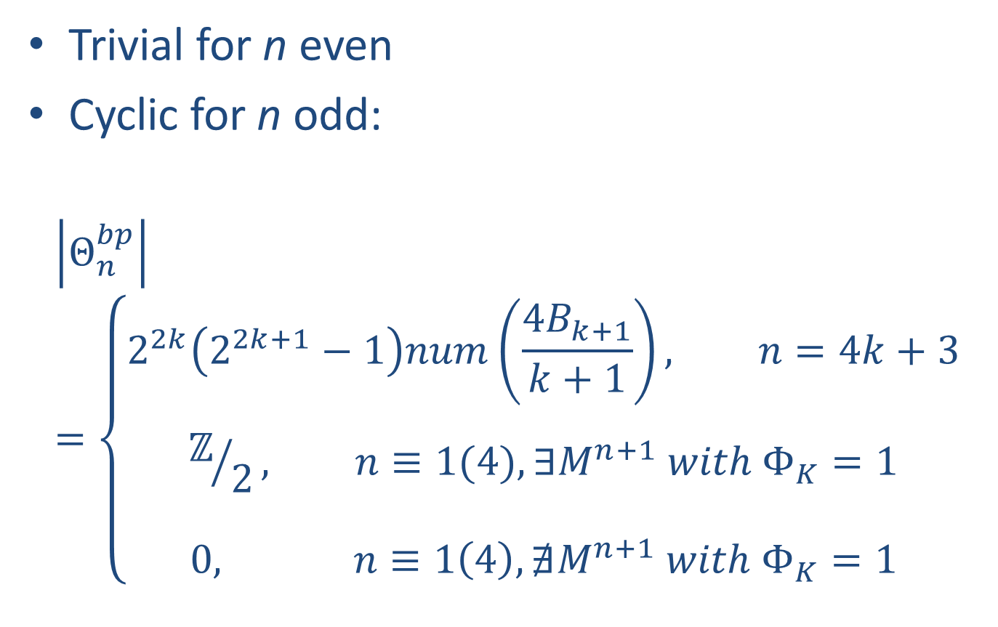
$$Θ_{n}^{bp}$$
Trivial for n even
Cyclic for n odd:
$$\left|Θ_{n}^{bp}\right|=\left\{\begin{matrix}\begin{aligned}2^{2k}\left(2^{2k+1}−1\right)num\left(\frac{4B_{k+1}}{k+1}\right), n=4k+3 \\ \end{aligned} \\ \begin{aligned}ℤ/2, n≡1(4), ∃M^{n+1} with Φ_{K}=1 \\ \end{aligned} \\ 0, n≡1\left(4\right), ∄M^{n+1} with Φ_{K}=1\end{matrix}\right.$$

Slide 24
KO Hurewicz homomorphism

Slide 25
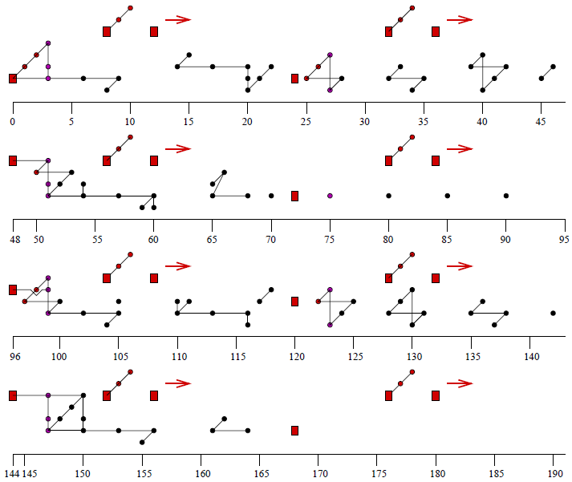

Slide 26
(πS)_{(p)} : p = 5
Computation: Ravenel
Picture: Hatcher
Notes:
Chromatic SS

Slide 27
(πS)_{(p)} : p = 5
Computation: Ravenel
Picture: Hatcher

Slide 28
(πS)_{(p)} : p = 5
Computation: Ravenel
Picture: Hatcher

Slide 29
Hurewicz image of TMF (p = 3)
Notes:
B-Pemmaraju ‘04

Slide 30


Hurewicz image of TMF (p = 2)
Notes:
B-Hill-Hopkins-Mahowald ‘08

